Slide 1
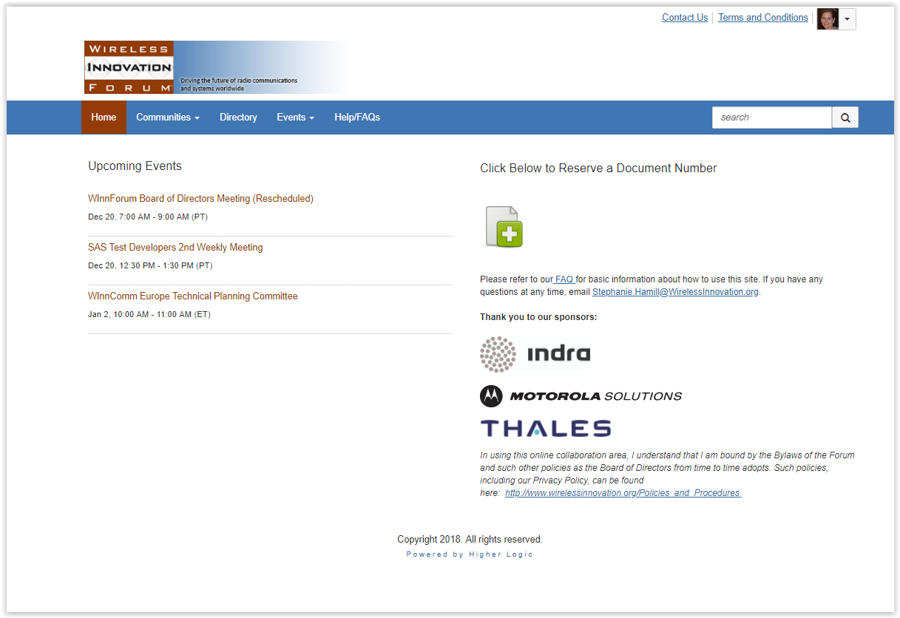
WInnForum Workspace ~ How to communicate with your groups

Slide 2
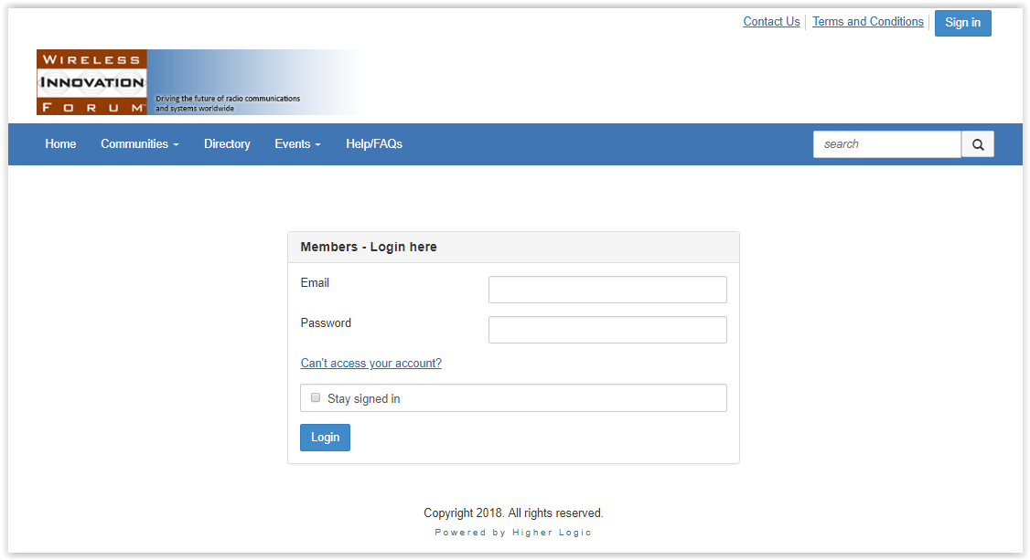
How to log in
Go to https://winnforum.connectedcommunity.org
Click the ‘sign in’ button in the top right corner
Click ‘can’t access my account’, enter your email address and you’ll receive an email to set up your password

Slide 3
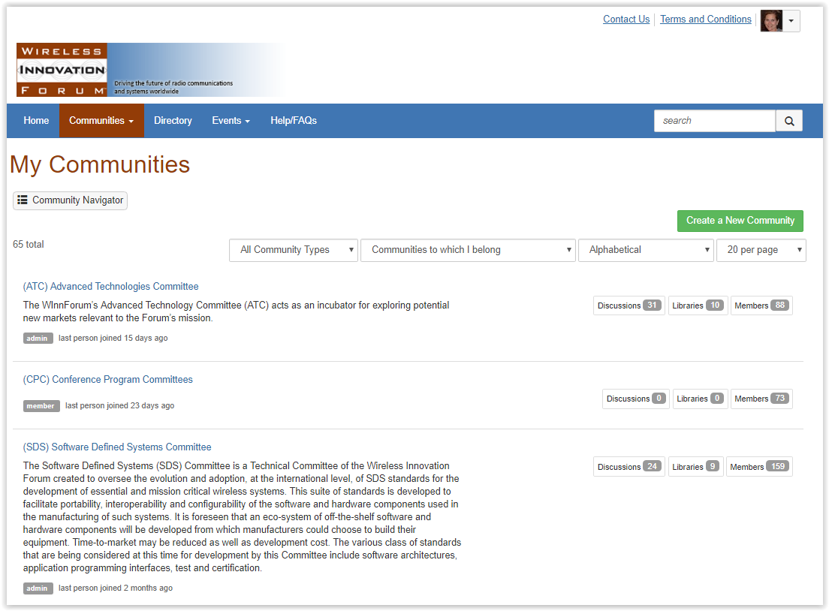
How to access your groups
Log on to https://winnforum.connectedcommunity.org
Click on the “Communities” tab.
Click on “My Communities” from the drop down menu.
To view a more compressed view of your communities, click on the “Community Navigator” tab.
Click on the name of the community you want to access to be taken to the “Community Home” page. This page will show the most recent listserv activity, announcements, document uploads and members.

Slide 4
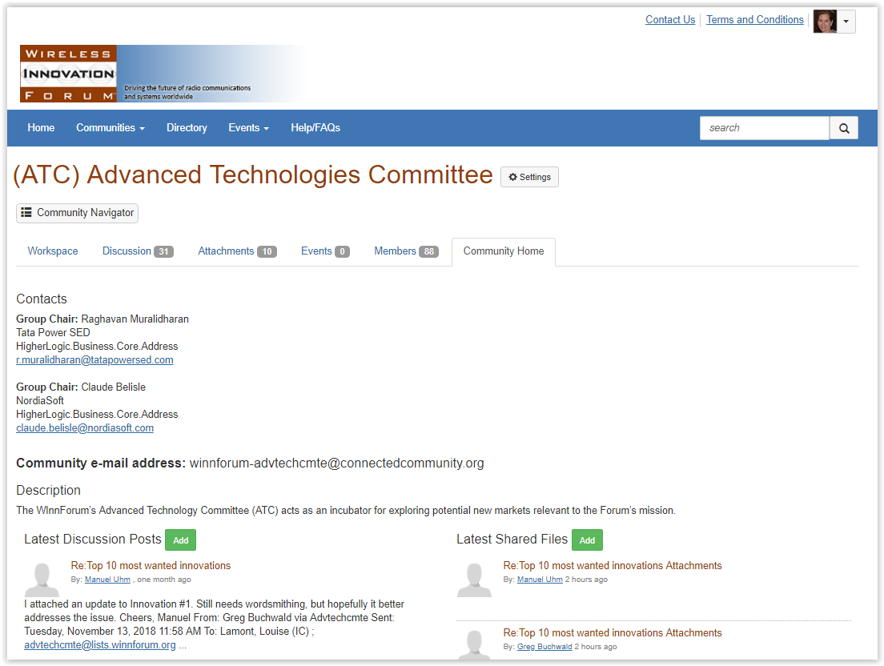
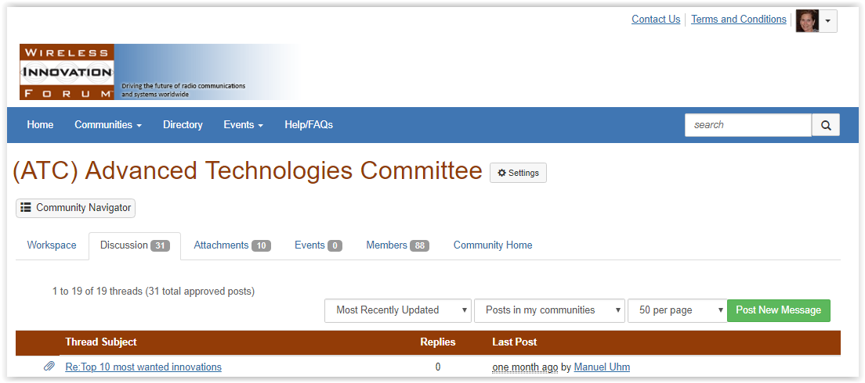
How to e-mail a group
Log on to https://winnforum.connectedcommunity.org
Click on “Groups” and then “My Communities” to find the community you would like to access.
On the “Community Home” tab, you will see the listserv address which you can use to send a message (with or without attachments) from your email tool.
Alternatively, you can post a message directly to the group by clicking on the “Discussions” tab then clicking on the green “Post a new message” button.

Slide 5
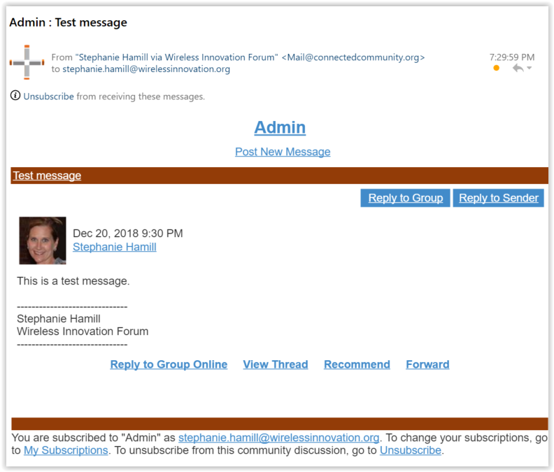
Replying to emails
If you are using your desktop mail tool to send and receive email messages, click “reply to group” to reply to the entire reflector or “reply to sender” in the body of the message to reply to just the sender of the message (or use the traditional “reply all” for the reflector or “reply” for sender.
To respond to a discussion post in Higher Logic, navigate to the discussion post in the “Discussion” tab and select how you would like to reply.

Slide 6
Questions:
Visit: https://winnforum.connectedcommunity.org/faq
Or email:
Stephanie.Hamill@WirelessInnovation.org
Lee.Pucker@WirelessInnovation.org
Jesse.Stallsmith@WirelessInnovation.org

